Slide 1
Cards and Actions using Outlook Actionable-Messages
Sending actionable messages

Slide 2

Sending actionable messages
Sending via Webhooks
Sending via SMTP
Sending via Microsoft Graph

Slide 3

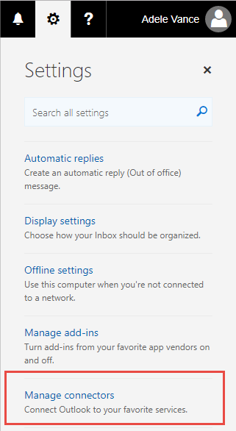
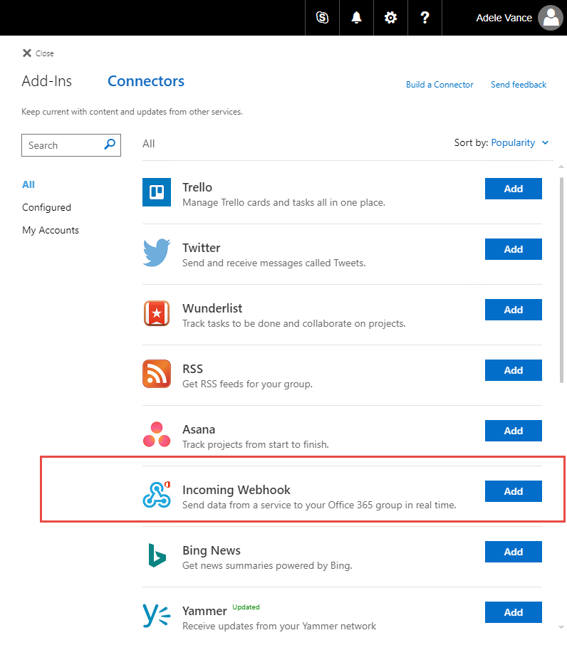
Create Incoming Webhook
Notes:
In your Office 365 inbox or on the Office 365 Group settings, click the gear icon and choose “Manage connectors”. On the Connectors page, choose “Incoming Webhook” and click “Add”.

Slide 4
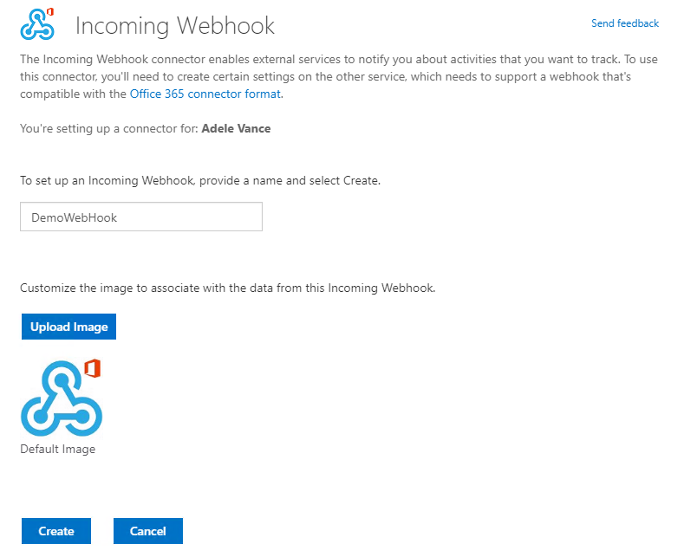
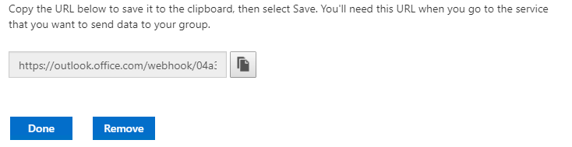
Configure Webhook
Notes:
On the Incoming Webhook page, provide a name and image for the Webook and click Create. The resulting URL allows you to POST JSON messages containing Actionable Messages card data to the endpoint, causing an email to be sent to the user or Office 365 Group for which the webhook is configured.

Slide 5

Actionable messages via WebHooks
1
HTTP POST to connector URL
Office 365
2
Retrieve email
Outlook
Your application
3
6
httpPOST action
HTTPS response
4
HTTPS POST+ bearer token
Office 365
5
HTTPS response + status
(optional refresh card)
Web app
Notes:
Action processing requires a publicly reachable endpoint that is pre-registered using the Actionable Email Developer Dashboard. You cannot use http://localhost as a URL because that is unreachable from Office 365.
User receives an email with an actionable message embedded in the <script> tag
User interacts with the message action defined in the card such as HttpPOST
The HTTP POST message is sent from Office 365 to the pre-registered endpoint. The HTTP POST includes a bearer token that should be validated.
The status is returned in the HTTP header CARD-ACTION-STATUS with a value indicating success or failure. Optionally, the response body can contain JSON to represent the new UI of the card after successful processing. This requires the CARD-UPDATE-IN-BODY HTTP header with a value of “true”

Slide 6


Actionable messages via email
1
Send email with card
2
Retrieve email
Outlook
Your application
Email servers
3
6
httpPOST action
HTTPS response
4
HTTPS POST+ bearer token
Office 365
5
HTTPS response + status
(optional refresh card)
Web app
Notes:
Action processing requires a publicly reachable endpoint that is pre-registered using the Actionable Email Developer Dashboard. You cannot use http://localhost as a URL because that is unreachable from Office 365.
User receives an email with an actionable message embedded in the <script> tag
User interacts with the message action defined in the card such as HttpPOST
The HTTP POST message is sent from Office 365 to the pre-registered endpoint. The HTTP POST includes a bearer token that should be validated.
The status is returned in the HTTP header CARD-ACTION-STATUS with a value indicating success or failure. Optionally, the response body can contain JSON to represent the new UI of the card after successful processing. This requires the CARD-UPDATE-IN-BODY HTTP header with a value of “true”

Slide 7

Actionable messages via email
POST
https://graph.microsoft.com/v1.0/users/{id}/messages/{id}/send
1
Microsoft Graph
Your application
Office 365
2
Retrieve email
Outlook
3
6
httpPOST action
HTTPS response
4
HTTPS POST+ bearer token
HTTPS response + status
(optional refresh card)
Office 365
5
Web app
Notes:
Action processing requires a publicly reachable endpoint that is pre-registered using the Actionable Email Developer Dashboard. You cannot use http://localhost as a URL because that is unreachable from Office 365.
User receives an email with an actionable message embedded in the <script> tag
User interacts with the message action defined in the card such as HttpPOST
The HTTP POST message is sent from Office 365 to the pre-registered endpoint. The HTTP POST includes a bearer token that should be validated.
The status is returned in the HTTP header CARD-ACTION-STATUS with a value indicating success or failure. Optionally, the response body can contain JSON to represent the new UI of the card after successful processing. This requires the CARD-UPDATE-IN-BODY HTTP header with a value of “true”

Slide 8
Demo

Slide 9

Summary
Send actionable message emails using mail server
The service must be registered with Microsoft
Can use webhooks to send JSON payloads representing cards
Can use Microsoft Graph to create applications that traverse relationships between entities and send actionable messages to individuals or groups

Slide 10
Thank you

